Slide 1
Challenge Problem 7: Influenza-Like Illnesses
Ssu-Hsin Yu, SSCI
Tom Dietterich, Oregon State
Chad Scherrer, Galois

Slide 2
Influenza-Like Illnesses (ILI)
5 million cases of severe illness each year world wide
200,000-500,000 deaths annually
Spreads by
contact of mucous with eyes, nose, mouth
inhaled aerosol particles
touch (e.g., hand-to-hand or hand-surface-hand)
Virus is shed one-half to one-day after infection for a period of 5 days (longer in children and immunocompromised people)

Slide 3
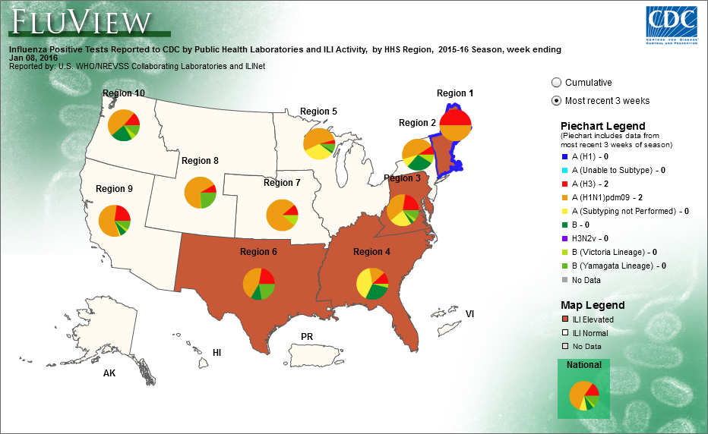
CDC U.S. Outpatient Influenza-like Illness Surveillance Network (ILINet)
Percentage of doctor visits that are flu-related
Weekly reports
Aggregated to CDC Regions
Broken out by age ranges
http://gis.cdc.gov/grasp/fluview/fluportaldashboard.html

Slide 4
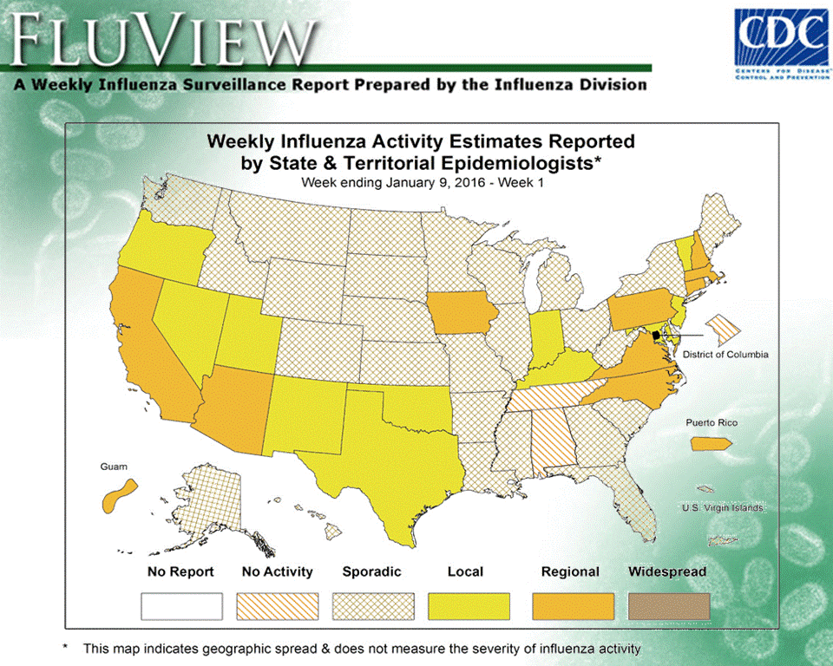
Weekly State-Level Estimates

Slide 5
State and District Reports (“Prediction Regions”)
State-level data
Massachusetts, North Carolina, Rhode Island and Texas
Within-state district data
Mississippi and Tennessee
Notes:
Title: change from county to district
First bullet: change from County-level to State-level

Slide 6
Useful Covariates
Tweets (per county per week)
keywords “flu” and “influenza”
number of tweets (not retweets)
Cumulative Vaccination Percentage (weekly) of Medicare recipients
Demographic information (population by age brackets)
Geographic information: adjacent counties
Notes:
Remove “; no multiple tweets from same user within 5 days” since this hasn’t been done for the current data.

Slide 7
Example Tweets

Slide 8
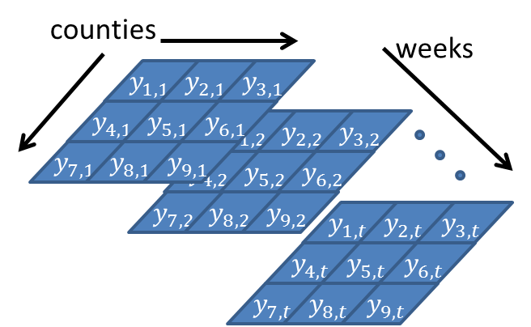
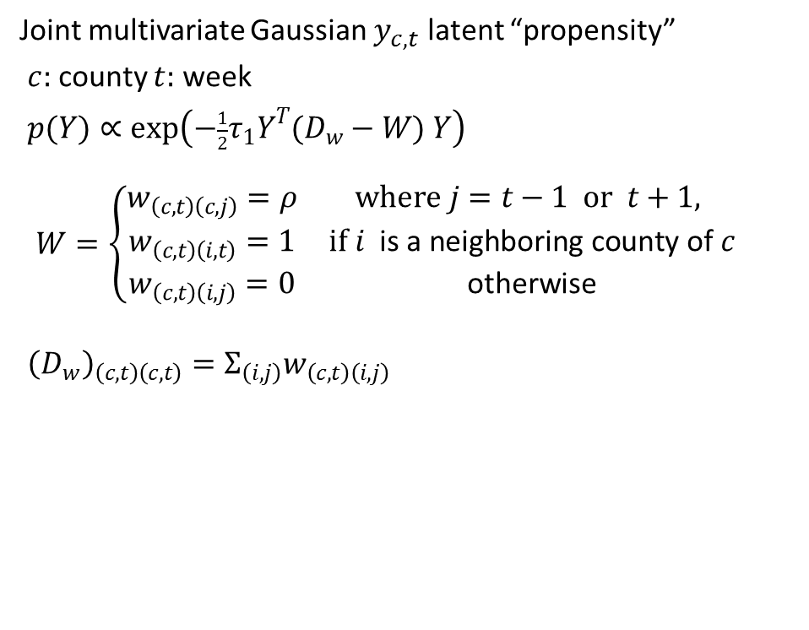
Proposed Model
Joint multivariate Gaussian $y_{c,t}$ latent “propensity”
$c:$ county $t:$ week
$p(Y)∝\exp\left(−\frac{1}{2}τ_{1}Y^{T}(D_{w}−W) Y\right)$
$$W=\left\{\begin{matrix}\begin{matrix}w_{\left(c,t\right)\left(c,j\right)}=ρ & where j=t−1 or t+1, \\ w_{\left(c,t\right)\left(i,t\right)}=1 & if i \text{is} \text{a} \text{neighboring} \text{county} \text{of} c \\ w_{\left(c,t\right)\left(i,j\right)}=0 & \text{otherwise}\end{matrix} & \end{matrix}\right.$$
${\left(D_{w}\right)}_{\left(c,t\right)\left(c,t\right)}=Σ_{\left(i,j\right)}w_{\left(c,t\right)\left(i,j\right)}$

Slide 9
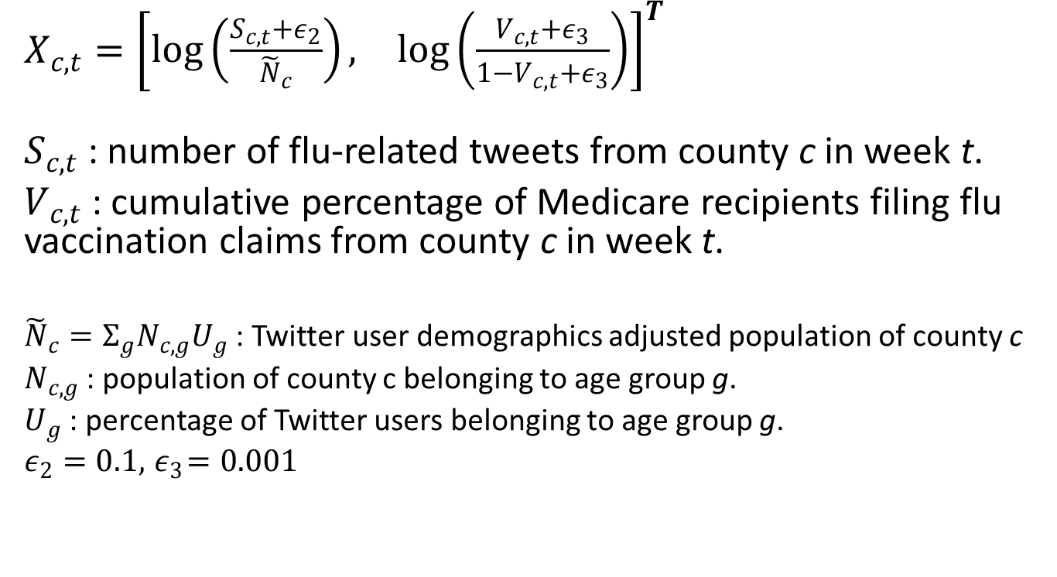
Covariates
$X_{c,t}={\left[\begin{matrix}\log\left(\frac{S_{c,t}+ε_{2}}{{\tilde{N}}_{c}}\right), & \log\left(\frac{V_{c,t}+ε_{3}}{1−V_{c,t}+ε_{3}}\right)\end{matrix}\right]}^{T}$
$S_{c,t}$ : number of flu-related tweets from county c in week t.
$V_{c,t}$ : cumulative percentage of Medicare recipients filing flu vaccination claims from county c in week t.
${\tilde{N}}_{c}=Σ_{g}N_{c,g}U_{g}$ : Twitter user demographics adjusted population of county c
$N_{c,g}$ : population of county c belonging to age group g.
$U_{g}$ : percentage of Twitter users belonging to age group g.
$ε_{2}=0.1, { ε}_{3}=0.001$

Slide 10
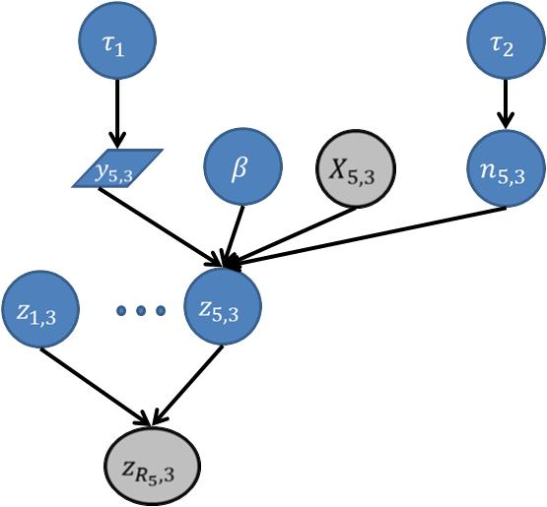
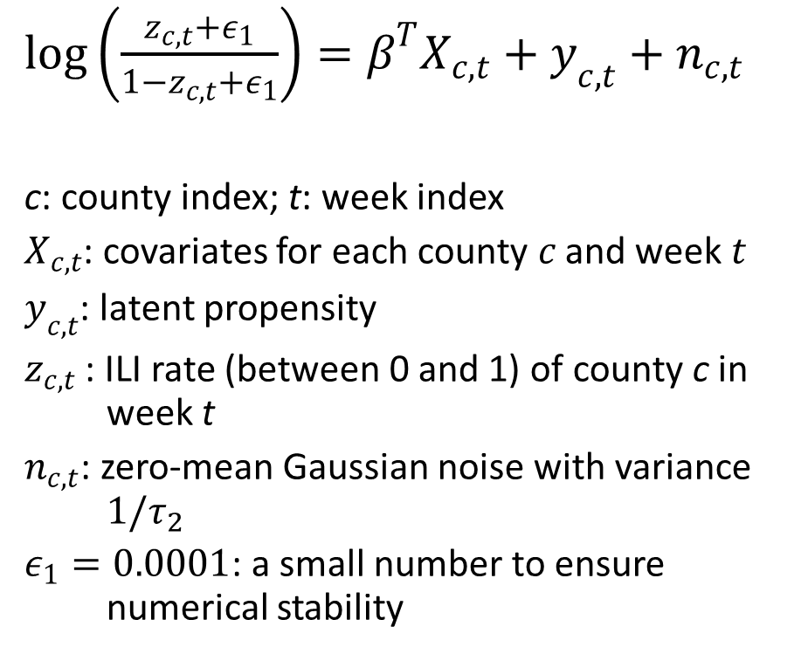
Flu Prevalence
$log\left(\frac{z_{c,t}+ε_{1}}{{1−z}_{c,t}+ε_{1}}\right)=β^{T}X_{c,t}+y_{c,t}+n_{c,t}$
c: county index; t: week index
$X_{c,t}$: covariates for each county $c$ and week $t$
$y_{c,t}$: latent propensity
$z_{c,t}$ : ILI rate (between 0 and 1) of county c in week t
$n_{c,t}$: zero-mean Gaussian noise with variance $1/τ_{2}$
$ε_{1}=0.0001$: a small number to ensure numerical stability

Slide 11
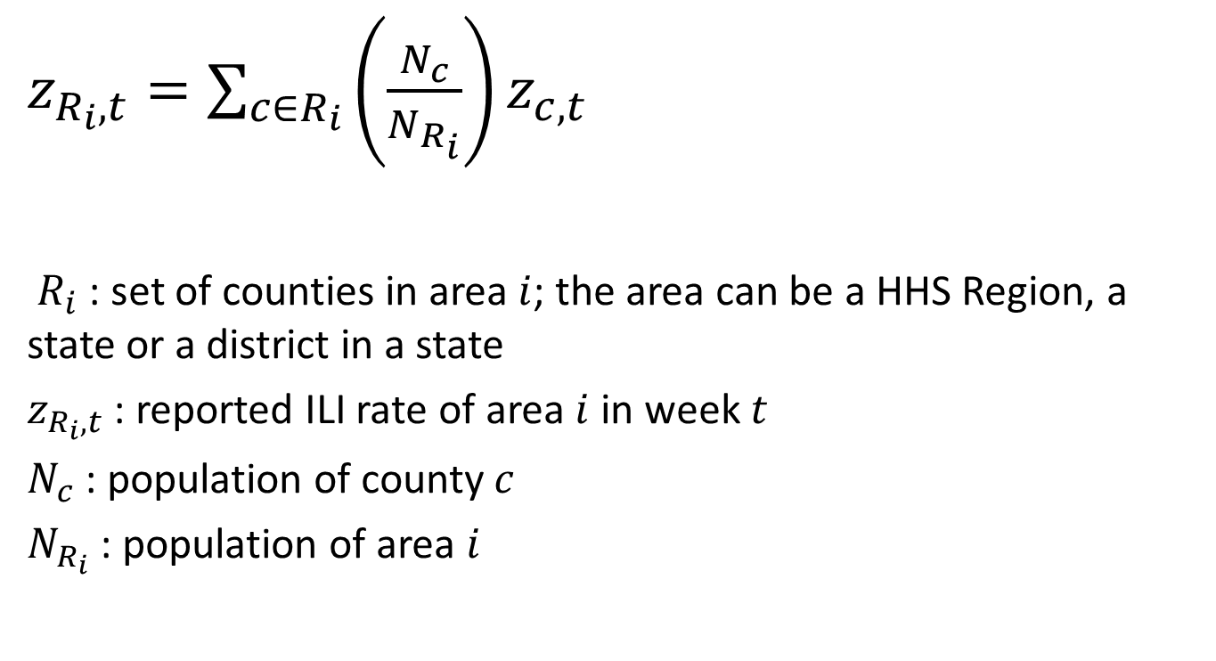
Aggregated Observations
$z_{R_{i},t}=\sum_{c∈R_{i}}{\left(\frac{N_{c}}{N_{R_{i}}}\right)}z_{c,t}$
${ R}_{i}$ : set of counties in area $i$; the area can be a HHS Region, a state or a district in a state
$z_{R_{i},t}$ : reported ILI rate of area $i$ in week $t$
$N_{c}$ : population of county $c$
$N_{R_{i}}$ : population of area $i$
Notes:
Change from “reported ILI rate of HHS Region $i$ in week $t" to "\text{reported} \text{ILI} \text{rate} \text{of} \text{area} i \text{in} \text{week} t$”
Change from “population of region $R_{i}$” to “population of area $i$“

Slide 12
Phase 1 Task: Reconstruction
Given:
weekly covariates and observations for an entire year
tweets, vaccination, CDC ILI reports + whole state estimates
Find:
weekly ILI prevalence for all counties in the Prediction Regions
Metrics:
Population-adjusted Squared Error
Start and Peak of the epidemic
Notes:
Remove “and districts”
I assume that they compute county ILI rates and we aggregate them to districts (for TN and MS) and states (for MA, NC, RI and TX) where we have truth data available.

Slide 13



















Phase 1
$$X_{1}$$
$$X_{2}$$
$$X_{3}$$
$$X_{4}$$
$$X_{5}$$
$$…$$
$$X_{52}$$
Tweets & Vaccinations
$$C_{1}$$
$$C_{2}$$
$$C_{3}$$
$$C_{4}$$
$$C_{5}$$
$$…$$
$$C_{52}$$
CDC Regions + CDC State Data
$$Z_{1}$$
$$Z_{2}$$
$$Z_{3}$$
$$Z_{4}$$
$$Z_{5}$$
$$…$$
$$Z_{52}$$
Prediction Regions

Slide 14
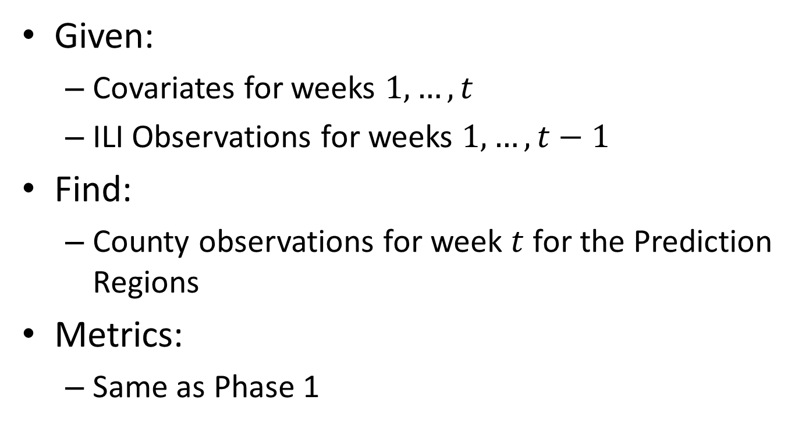
Phase 2 Task: Weekly Nowcast for 2015-16
Given:
Covariates for weeks $1,…,t$
ILI Observations for weeks $1,…,t−1$
Find:
County observations for week $t$ for the Prediction Regions
Metrics:
Same as Phase 1

Slide 15





Phase 2
$$X_{1}$$
$$X_{2}$$
$$X_{3}$$
$$X_{4}$$
$$…$$
$$X_{t−1}$$
$$X_{t}$$
Tweets & Vaccinations
$$C_{1}$$
$$C_{2}$$
$$C_{3}$$
$$C_{4}$$
$$…$$
$$C_{t−1}$$
CDC Regions + CDC State Data
$$Z_{t}$$
Prediction Regions

Slide 16
Challenge Problem Dimensions
Domain Class
Data Structure
Model Structure
Query Structure
DoD-related
Platforms
ISR
C3
Intelligence Analysis
Types:
Continuous
Discrete
Hybrid
Directed?:
Directed
Undirected
Query Type:
MAP
Marginal MAP
Expectation
Posterior Distribution
Posterior Summary
Anomalies
Structure:
Vector
Relational
Sequence
Spatial
Parametric?:
Parametric
Nonparametric
Industry
Platforms
C3
# of Objects or Entities:
Fixed
Variable
Query Timing:
One shot
Amortized
Tracking
Medicine and Science
Bird migration
Brain segmentation
Influenza
Content:
Signals
Counts
Tracklets
Text
Images
3D MRI images
Aircraft tracks
Operational Tempo:
Fast
Slow
Latent Variables?:
Observed
Latent
Stationarity:
Stationary
Change points
Both
Notes:
I made “Sequence” boldface since we also have temporal correlations.

Slide 17
CP#7 Next Evaluation Period
Timeline
PI Meeting – 90 days: Beta Period Begins
PI Meeting – 45 days: Final Deadline for CP6 and CP7 solutions
July ??: PI Meeting

Slide 18
CP#7 Materials Available Now
http://ppaml.galois.com/wiki/wiki/CP7FluSpread
http://ppaml.kitware.com/midas/
Email address for questions, issues, etc.:
ppaml-support@community.galois.com
Micro-breakout today at 1:30pm

Slide 19
Future Challenge Problems
CP8: Recognition of Interleaved Desktop Activities
CP9: Anomaly Detection??
CP10: Exploratory Data Analysis Hackathon??
Micro-Breakout Monday at 1:30pm

Slide 20
PPAML Summer School 2016
Where:
Portland, Oregon
When:
July 25th to August 5th, 2016
How:
Online Announcement
http://ppaml.galois.com/wiki/wiki/SummerSchools/2016/Announcement
Application Form
https://www.tfaforms.com/406358
Email and forum announcements forthcoming

